Slide 1

BTEC UNIT 18 • DIGITAL ANIMATION
Purpose & Applications
Exploring the core functions, industry sectors, and target audiences of digital animation in modern media production.

Slide 2

TOPIC OVERVIEW
Why Do We Animate?
Understanding the fundamental motives driving digital animation creation across global industries.

Slide 3










Primary Purposes of Animation
Entertainment
Education & Training
Commercial & Promo
Storytelling through feature films, TV shows, and animated series to captivate and emotionally engage diverse global audiences.
Simplifying complex academic concepts, medical procedures, and corporate safety protocols through clear visual demonstration.
Driving brand awareness, product launches, and targeted advertising campaigns with dynamic, memorable visual effects.

Slide 4


Specialized Applications
Scientific Visualization
Architectural Simulation
Rendering subatomic particles, biological cell interactions, and astronomical phenomena that cannot be captured with real-world camera lenses.
Creating immersive 3D walkthroughs, structural stress tests, and urban development models before physical construction commences.

Slide 5

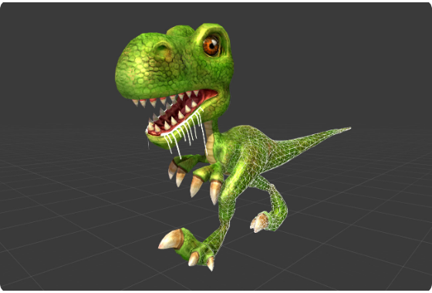
Entertainment & Gaming
Key Production Elements
•
Feature Films & VFX: High-end 3D CGI integrated seamlessly into live-action pipelines for blockbuster cinema.
•
Interactive Gaming: Real-time animation engines (Unreal, Unity) powering player avatars, NPCs, and environments.
•
Rigging & Motion Capture: Translating actor movements onto digital character skeletons for realistic expressions.

Slide 6
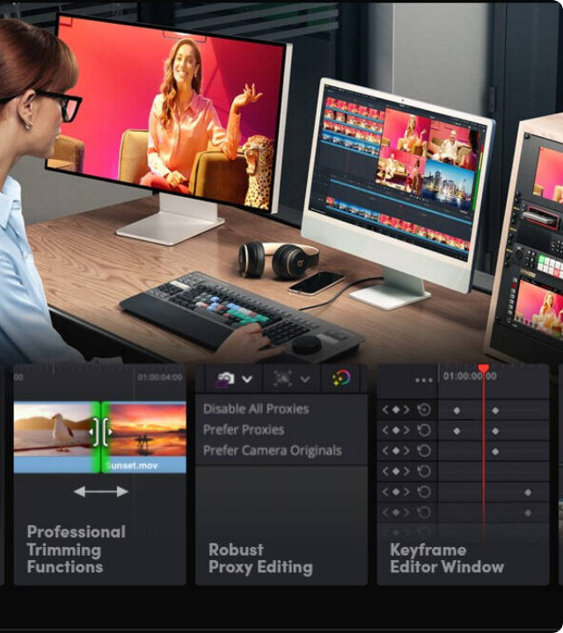
Advertising & Marketing
Visual Impact in Marketing
Animated explainer videos increase viewer retention by up to 80% compared to static text or traditional images.
Motion graphics allow brands to transform abstract value propositions into memorable, bite-sized visual narratives tailored for social media feeds and broadcast TV.

Slide 7

Audience Engagement Metrics
The Power of Visual Storytelling
Studies consistently demonstrate that audiences retain 95% of a message when viewing it in video or animated format, compared to just 10% when reading static text.
Integrating animated elements across digital platforms significantly boosts user dwell time and brand recall.
Higher Conversion Rate

Slide 8
UI/UX & Web Animation
Micro-Interactions: Subtle hover states, animated toggle switches, and progress bars provide instant visual feedback to users.
Seamless Transitions: Smooth page loads and animated modal entries eliminate jarring visual cuts during navigation.
Lottie & Vector Animation: Lightweight, scalable SVG animations keep web pages fast while enhancing aesthetic appeal.
Accessibility Focus: Respecting reduced-motion media queries ensures animations enhance rather than hinder usability.

Slide 9
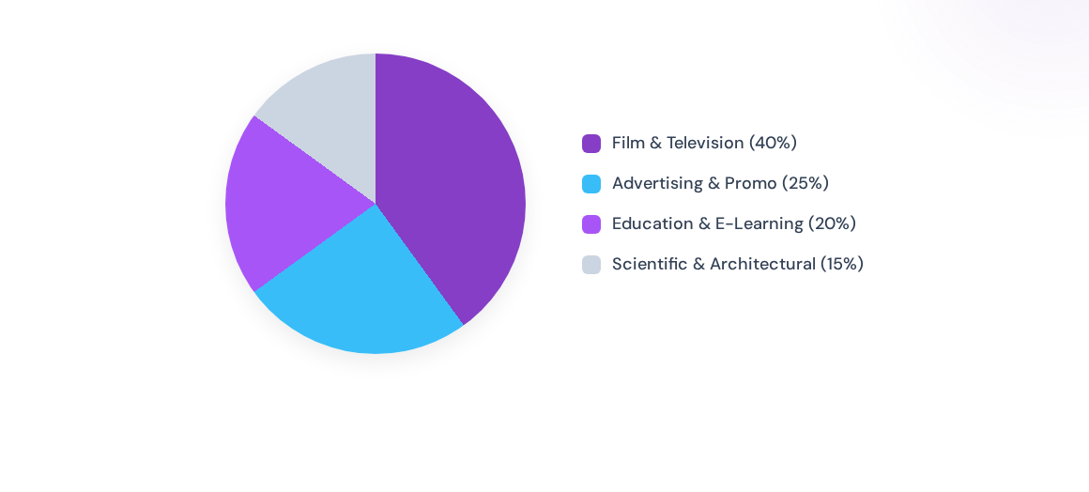
Animation Industry Distribution
Entertainment remains the largest sector, but commercial advertising and corporate e-learning represent rapidly expanding markets for digital animators.

Slide 10
Animation Mediums Comparison
Medium | Render Time | Visual Realism | Primary Use Case
2D Vector | Fast (Real-time) | Stylized / Stylistic | Web UI, Mobile Games, Cartoons
3D CGI | Heavy / Slow | Photorealistic to Stylized | VFX, Feature Films, AAA Games
Motion Graphics | Moderate | Abstract / Geometric | Commercials, UI, Title Sequences
Stop Motion | Manual / Practical | Tactile / Physical | Specialty Films, Indie Animation

Slide 11




Production Workflow Overview
2. Production
4. Delivery
Asset creation, rigging, keyframing, and lighting setup.
Exporting to required codec, format, and platform testing.
1. Pre-Production
3. Post-Production
Brief analysis, storyboarding, character design, and audio scripting.
Rendering, compositing, visual effects, and audio mixing.

Slide 12
WEEK 1 SUMMARY
Questions & Discussion
Complete the Product Analysis activity in the repository before next week's session on Copyright & Legal Requirements.
BTEC Level 3 Digital Animation • Unit 18

Slide 13


Image Sources
https://manu.ninja/images/raptor.jpg
Source: manu.ninja
https://microless.com/cdn/products/46366da5ef850a0f4c34132ab29593d1-hi.jpg
Source: global.microless.com

